Slide 1
Intro to AI/Machine Learning

Slide 2
Overview
01
02
03
04
What is DS and Machine Learning?
Types of ML
Pandas + KNN
Coding Time!

Slide 3
What is DS and Machine Learning?

Slide 4
What is Data and Big Data?
Data
Big Data
Any unprocessed fact, value, text, sound, or photo
Refers to extremely large, diverse datasets that adheres to the three Vs:
- containing greater variety
- Arriving in increasing volume
- With more velocity

Slide 5
What is Data Science?
Data science is at the intersection between computer science, statistics, and information science. It requires a delicate balance of leverage the idealistic statistical methods against naturally noisy and imperfect real-world data.

Slide 6
What is Machine Learning?
Computers learning the solution to a problem by applying algorithms to data, rather than being directly told what to do.

Slide 7
Why do we need Machine Learning?
Why doesn’t it work to tell the computer exactly what to do?

Slide 8
ML Process
1
3
5
2
4
Validate + Improve
Prepare data
Train + Test
Collect raw data
Choose a model

Slide 9
3 Main Types of ML
01
02
03
Supervised Learning
Unsupervised Learning
Reinforcement Learning

Slide 10
Types of ML

Slide 11
Supervised Learning
The computer is given data, and the programmer asks the model to determine the relationship between the input and the output variables. This comes in 2 main forms of classification or regression.

Slide 12
Classification vs. Regression
Classification
Regression
Trying to split data. It seeks to accurately assign data to different categories.
Trying to fit data. It seeks to understand relationships between dependent and independent variables

Slide 13
Unsupervised Learning
The computer is given data with no direction from the programmer, and the computer finds hidden patterns.

Slide 14
Reinforcement Learning
A model that improves upon itself in new situations using a trial-and-error method - very similar to how humans learn.

Slide 15
Pandas + KNN

Slide 16
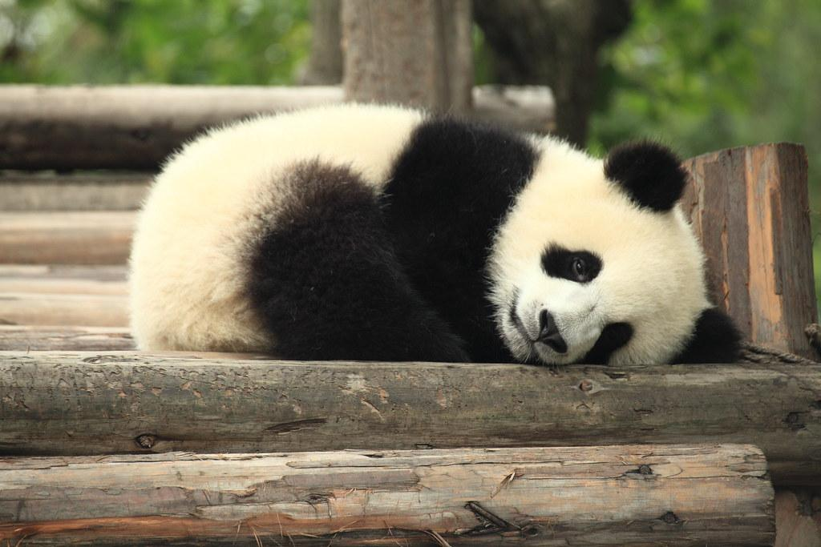
Pandas
Pandas is a python library that is widely used to read, analyze, and clean data, It serves as the backbone of most data projects.

Slide 17
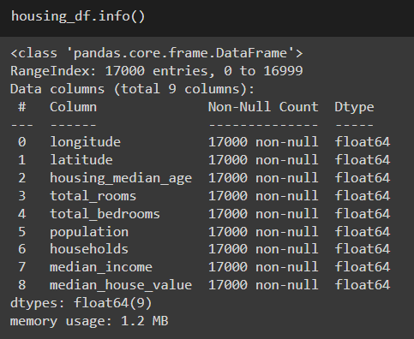
Check out the cheat sheet for more!

Slide 18
KNN (K-Nearest-Neighbor)
a supervised learning algorithm that classifies data into groups based on the proximity of the data points. KNN assumes that closer data points are more similar to each other.

Slide 19
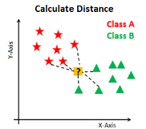
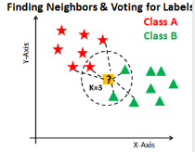
01
02
KNN Process
When we get a new data point, the model computes the “distance” to every training data point.
The model then looks at the classes of the k nearest training data points(where the name comes from). Then, the model takes a majority vote of these classes and returns the result as its prediction.

Slide 20
Coding Time!🤠

